Slide 1

ITSA GOURDS Mask E-Commerce
Lee Wei Han Sean
Li KangZheng
Seow Jian Liang Job
Wayne Loh
Wong Xian Rui Abel

Slide 2
Overall Solution Design and Development

Slide 3
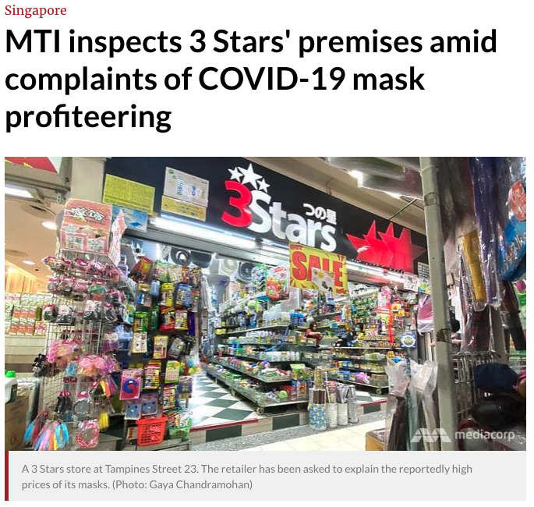
Project Context
Covid-19 Pandemic
Panic Buying of Masks
Mask Profiteering from Pandemic
Shortage of Masks

Slide 4
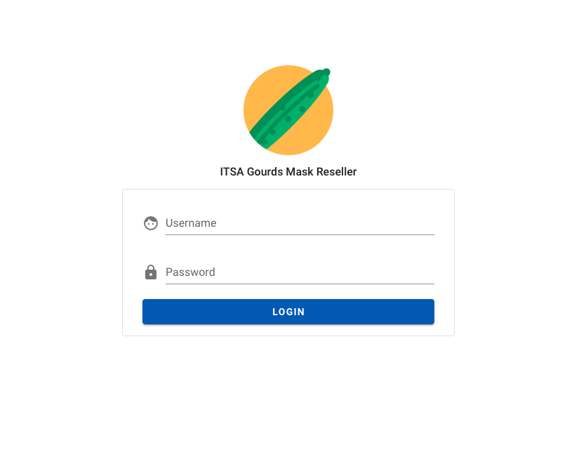
Mask E-Commerce
1. Comfort of your home
2. Controlled Pricing
3. Anti Hoarding
4. Social Distancing

Slide 5
Key Qualities
Maintainability
Availability
Security
Performance
CI/CD
Test cases
Loose Coupling, High Cohesion
Singleton Design Pattern
Façade Design Pattern
README.md
99.99% uptime between 8am – 12pm daily
Redundancy for system failure
Persistent state
No authorised access to protected pages and APIs
No SQL Injection
No breach of data confidentiality
No breach of data integrity
DDoS Protection
1 second initial web page load with 10,000 requests
Handle 100 concurrent users

Slide 6
Architecture
Diagram

Slide 7
Layered Diagram

Slide 8
Maintainability Design and Implementation

Slide 9
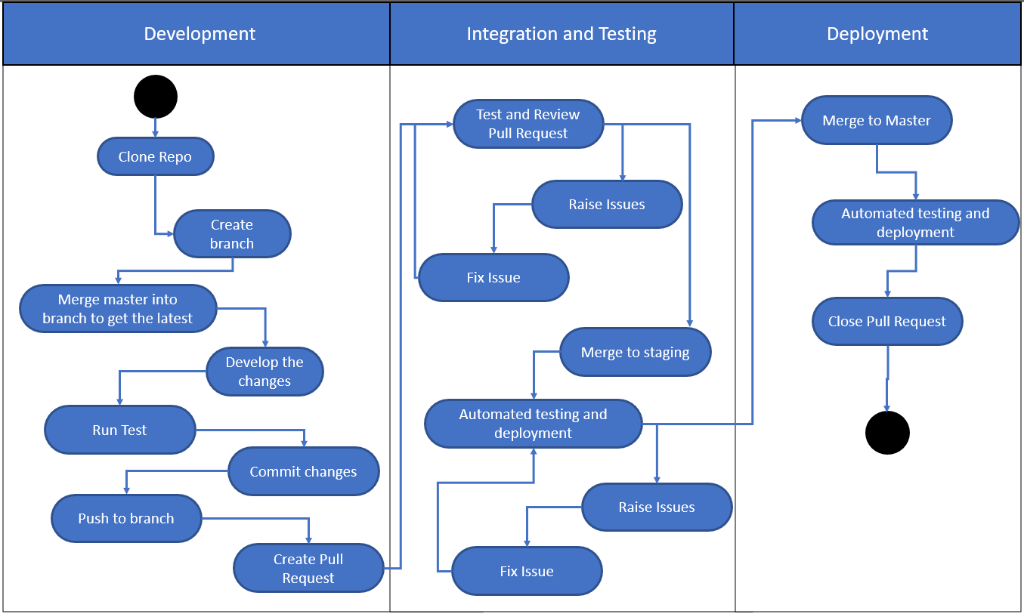
Activity Diagram

Slide 10
Ease of Maintainability
Architectural Styles
Microservices
Design Patterns
Multi-tenancy
Logical Layers
User Interface
Business Logic
Data Layer
Tiered Architecture
Client > Proxy > Server
Microservice Architecture
Decoupled services
Testing
Deployment
Singleton Design Pattern
Improve database efficiency
Façade Design Pattern
Hide complexity
Common database for all backend API instance
In the event of database failure, auto recovery procedure will spin up a new instance

Slide 11


Other maintainability
designs
README.md
Readme file for future deployments
API Naming Convention
Follow best-practices for readability

Slide 12
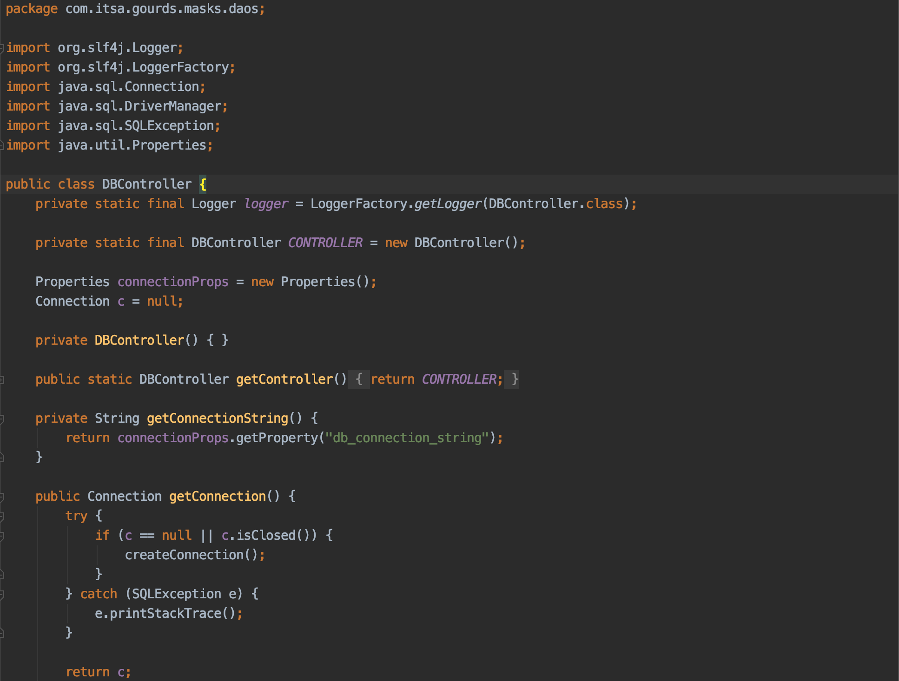
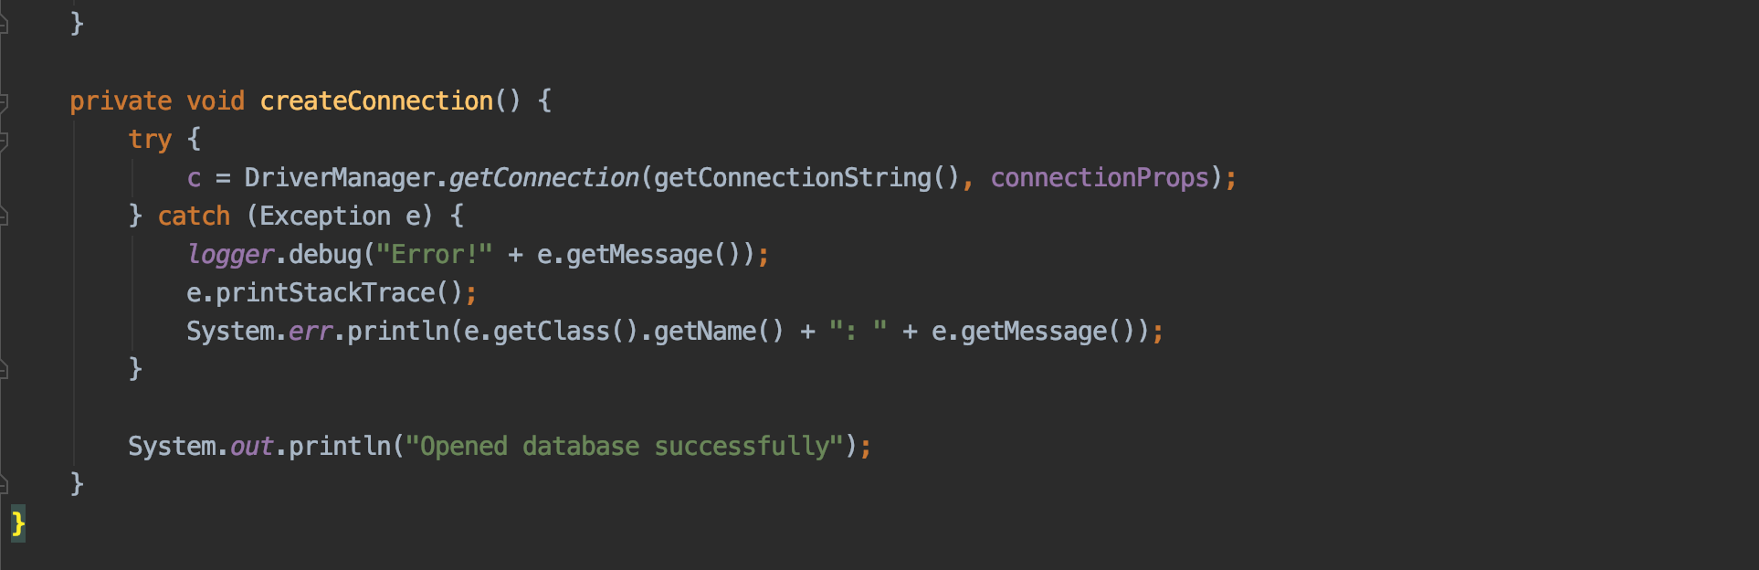
Design Pattern
Singleton
Façade

Slide 13
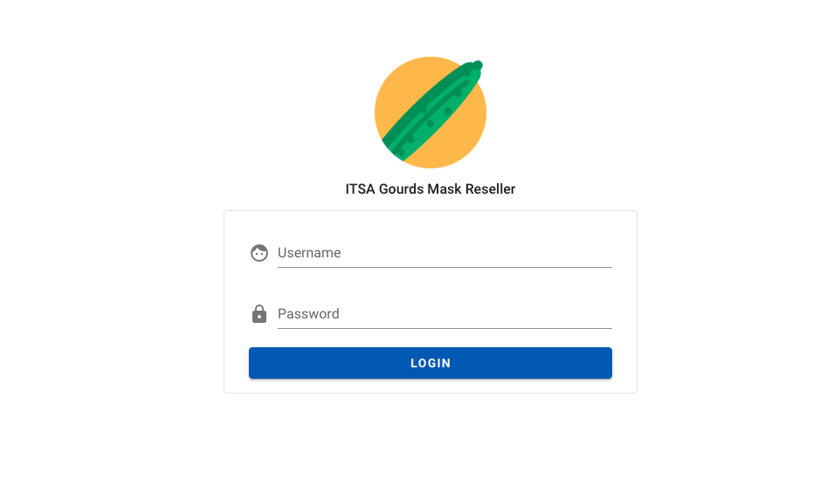
Availability Design and Implementation
PITCH
PITCH

Slide 14


Availability Design
AWS Elastic Beanstalk
Load balance between instances
Local Storage
Store user session on client system
AWS RDS
Failover with Multi A-Z deployment

Slide 15
Security Design and Implementation

Slide 16





Key Vulnerabilities
DDoS
DDoS Protection using Cloudflare
MAN-IN-THE-MIDDLE
HTTPS
SQL Injection
Prepared Statement
Unauthorised Access
JWT/CORS

Slide 17
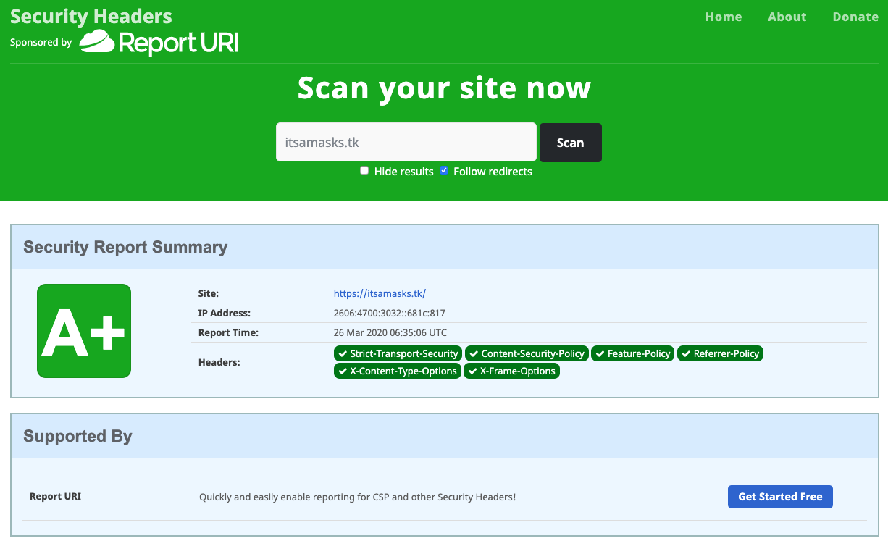
HTTPS

Slide 18
Performance Design and Implementation

Slide 19
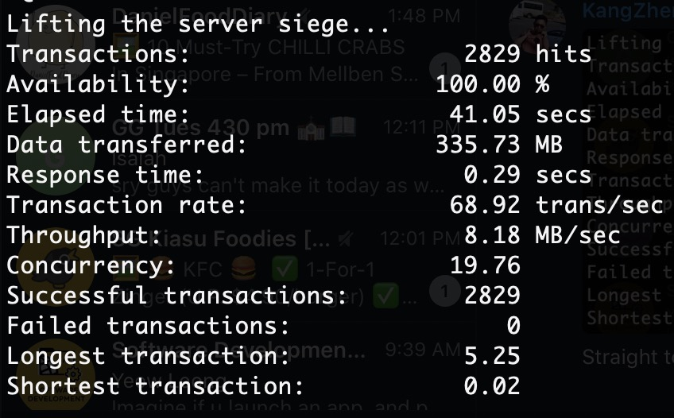
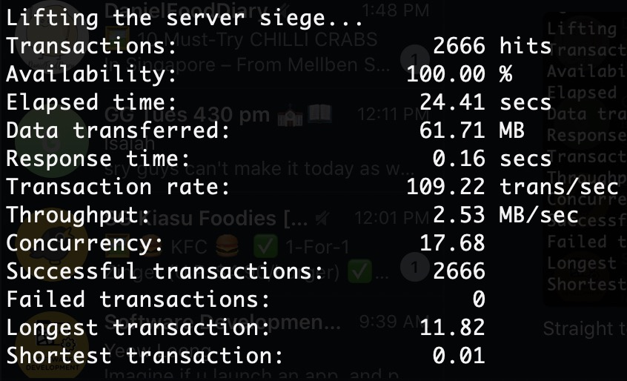
Static Website Caching
1 instance, without proxy
1 instance, with proxy

Slide 20
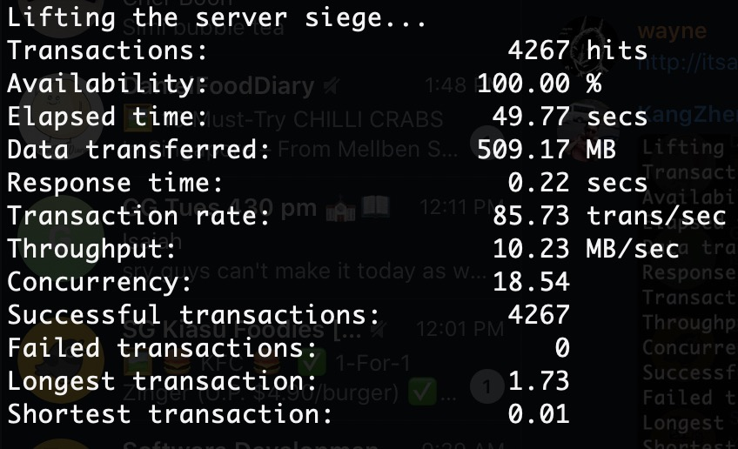
Two instances with load balancing (Frontend)
1 instance, without proxy
2 instances, without proxy

Slide 21
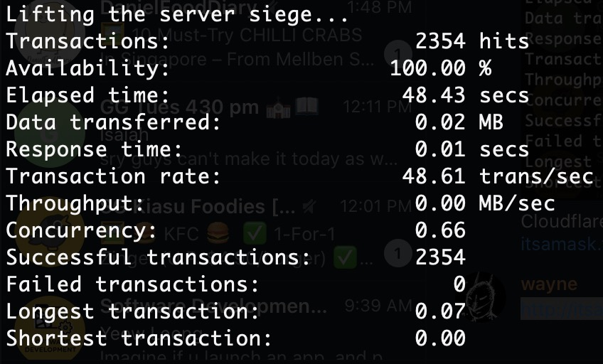
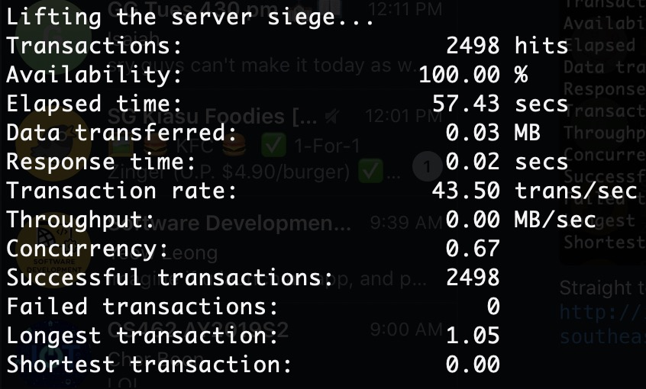
Two instances with load balancing (Backend)
1 instance
2 instances

Slide 22
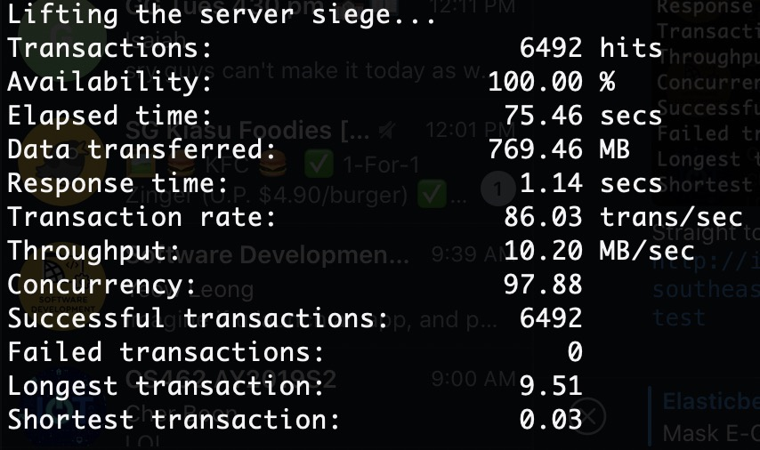
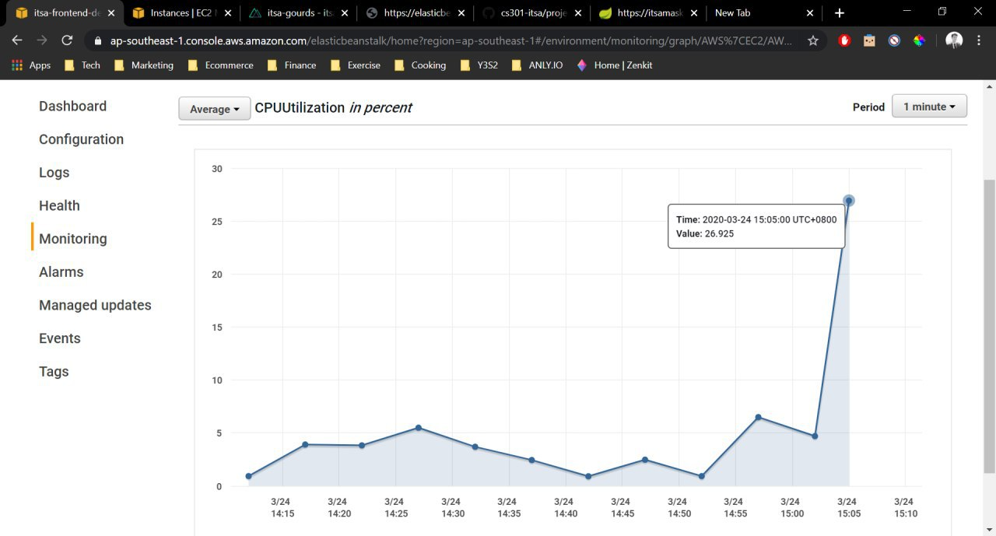
Breaking point for 1 instance
26.925%
1 instance, no proxy

Slide 23
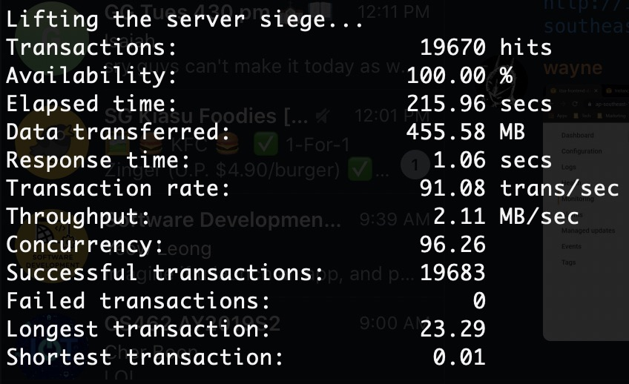
Performance for full setup
2 active instances, 1 passive instance, proxy

Slide 24


Other performance design
Single Page Application
Minimise strain on backend server
DB Read Replication
Allow faster read operations on database

Slide 25
THANK YOU

